Slide 1
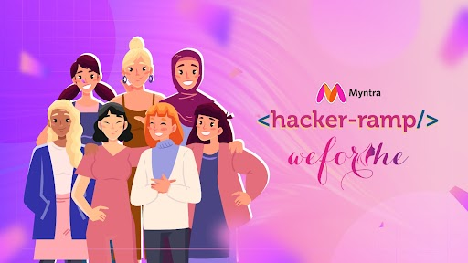
Team Name : TSM
Team Details :
Aafiya Choudhary,​
Simpy Kumari Mandal,
Tvisha Mathur

Slide 2
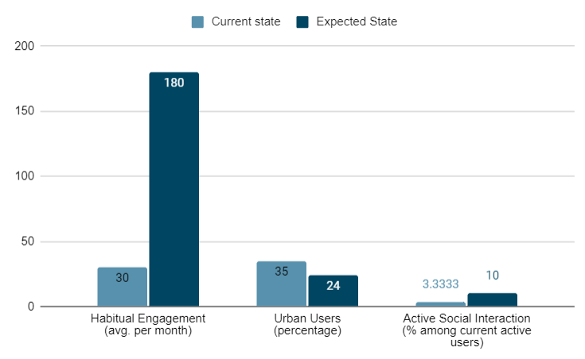
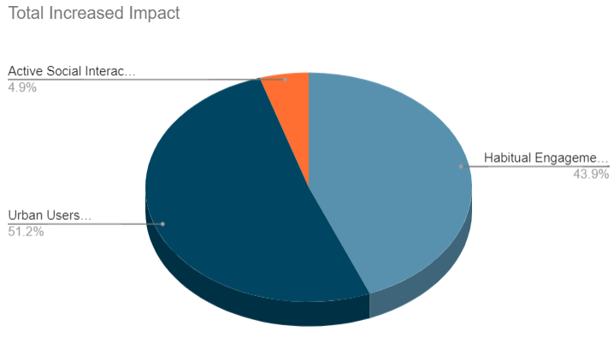
Problem Statement
In 2024, Myntra's monthly active users touched the 60 million mark, with 6 million customers making 30 visits to the platform each month on average, according to the fashion and beauty e-retailer’s trend report.
Despite attracting nearly 75 million new users in the past year, with 65% from non-metro cities, the online fashion industry still struggles to replicate the social and interactive aspects that are crucial for engaging younger audiences. The fashion industry thrives on constant change and self-expression, especially among younger audiences. However, online shopping often lacks the social and interactive elements that drive habitual usage, and position Myntra as the go-to destination for fashion enthusiasts.
Scale and Impact of the problem
The scale of the problem is significant:-
Limited user engagement: 2 million monthly, Small portion of the 60 million user base.
Relatively low frequency of average visits: 30 per month.
High return rates: Increased customer service workload.
and a lack of social interaction
Impact
Total Increased Impact

Slide 3
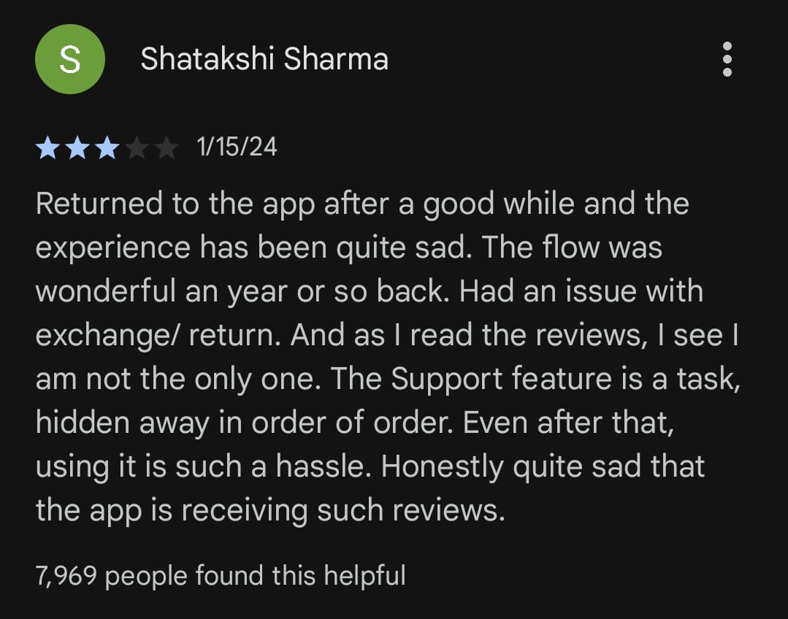
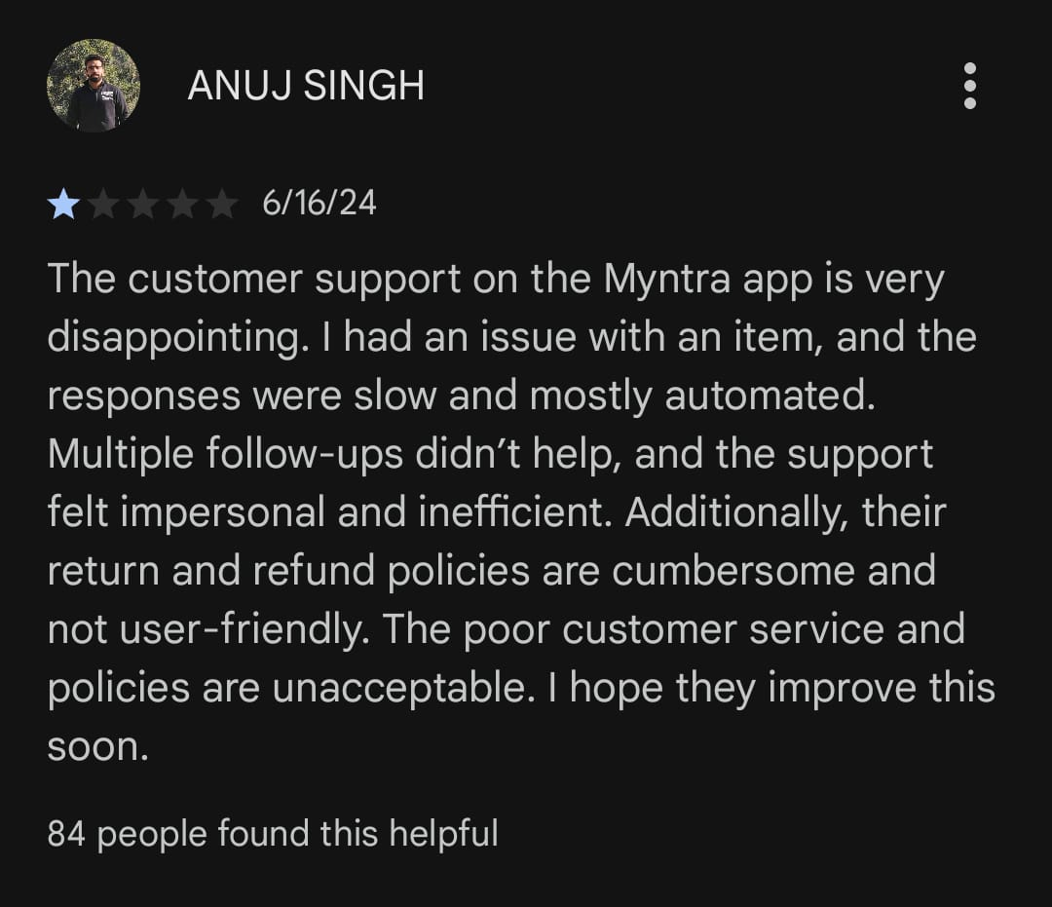
Solution
Ensuring 360° Social Engagement and Viral fashion trends among Gen Z users with Social Media like functionalities, Style Battles and Collaborations, Customizable Virtual Try-On and Rewards
1. Virtual Try-On with User-Alike Dummies:
Users can create and style dummies that resemble their physical appearance, offering a realistic preview of clothing items.
Enables users to configure complete outfits by choosing each piece separately.
Enhances user confidence in purchasing decisions reducing the likelihood of returns.
2. Dummy Styling Battles:
Creating interactive and collaborative constructs where users can participate in styling battles segmented by regions and categories.
Encourage engagement among Gen Z users by showcasing their fashion sense and compete for the best styles.
3. Incentivized Rewards System:​
Develop a dynamic rewards program, providing tangible benefits for active users.​
Offer coupons, secret offers, hidden gifts and rewards based on users' participation and performance in styling battles.​
Incentivizing engagement will encourage repeat visits​
​
4. Interactive Social Media-Like Feed:​​
Introduce an Instagram-like feed for users to post images and videos of styled dummies and themselves.
Enable interaction with posts through likes, comments, shares, and saves.
Foster social interaction and community engagement within the platform.
Additional Features:​
5. Enhanced Token based Customer Care System. 6. Appealing UI according to Gen Z Preferences:
References:

Slide 4
Benefits
1. Virtual Try-On with User-Alike Dummies:
With the virtual try-on feature, users can see how clothes will look on their personalized dummies, reducing uncertainty and return rates.
This will alleviate the burden on customer service and improve user satisfaction.
The new virtual try-on and posting features will likely attract 2 million monthly users already engaging with features like MyFashionGPT and Maya, increasing overall engagement.
2. Interactive Social Media-Like Feed and Dummy Styling Battles:
By providing social media-like functionalities, such as posting custom styles on dummies or themselves, users will be encouraged to visit the app 5-6 times a day (avg 150-180 per month), leading to habitual engagement.
Will drive connectivity virality among younger audiences in the country.
By offering features like region-wise and category-wise style battles, creating unique looks, challenging friends, and gaining recognition, the platform will attract Gen Z users.
3. Incentivized Rewards System:
The results-based reward incentive system will engage users, making Myntra their go-to app for recommending looks to friends and showcasing their fashion choices.
(Additional Benefits)
4. Appealing UI according to Gen Z Preferences:​
Increased Engagement, Enhanced User Experience.​
Higher conversion rates as users are more likely to complete purchases.​
Encourages users to visit frequently, fostering habitual usage and loyalty to the platform.​
5. Improved Customer Care:​
Improved Customer Satisfaction.​
Reduced return rates, Increased loyalty of customers.​
Efficient issue tracking, Time savings, Positive reviews and referrals.
​

Slide 5
Feasibility & Workflow
Contact us
Open "Profile section" in Myntra App
Customize Avatar (New Feature)
My Fusion (New Feature)
Myntra Fwd
Social media functionalities like posting, liking, sharing, commenting, and following are well-established features with numerous existing solutions.
Feasibility:
Feasible: Integration with third-party APIs (e.g., Facebook SDK) or developing an in-house system is achievable by carefully planning and managing user authentication, content moderation, and user privacy.​​
Feasibility : Challenging, but Achievable: 3D model customization with body parameter adjustments requires expertise in 3D modeling and animation.
Raise Query (New Feature)
Feasibility :
Feasible: By determining the token acquisition process, managing token validity, and integrating with existing customer support system.
VIRTUAL- TRY ON Feature
(New Feature)
Feasibility :
Moderately Challenging: Virtual try-on, Accurate pose estimation, garment simulation on a user's 3D model requires advanced computer vision and machine learning techniques.
Step 1: User accesses "Customize Dummy" in their profile.
Step 2: Customizes 3D model parameters (face shape, skin color, body measurements).
Step 3: Saves personalized dummy settings.
Step 1: User accesses "Raise Query" in contact section.
Step 2: Submits query through token-based system.
Step 3: Tracks query status and receives resolution updates.
Step 1: User selects a clothing product.​
Step 2: Clicks on "Virtual Try-On" button.​
Step 3: Views product on their customized 3D dummy.​
Step 4: Adds up to three items per outfit (upper, lower, optional accessory).​
Step 5: Takes snapshot of styled outfit.​
​
Step 1: Users engage with posts (like, share, comment, save).
Step 2: Follow other users for style inspiration.
Step 3: Build a follower base and grow social presence.
Regional and Category-wise Competitions:
Step 1: Myntra hosts competitions based on post engagement.
Step 2: Users participate by posting styled outfits.
Step 3: Winners receive coupons, discounts, or hidden gifts.
Step 1: User accesses "My Fusion" section.
Step 2: Uploads snapshot of styled outfit.
Step 3: Adds additional accessory images.
Step 4: Tags location and adds hashtags.
Step 5: Publishes post for community engagement.

Slide 6
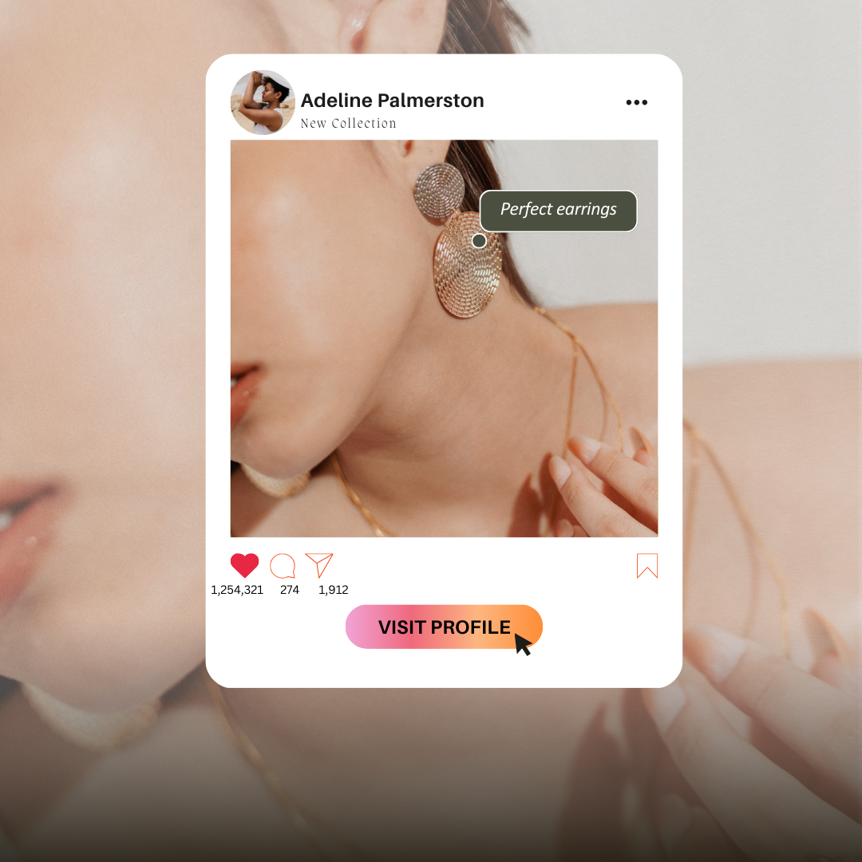
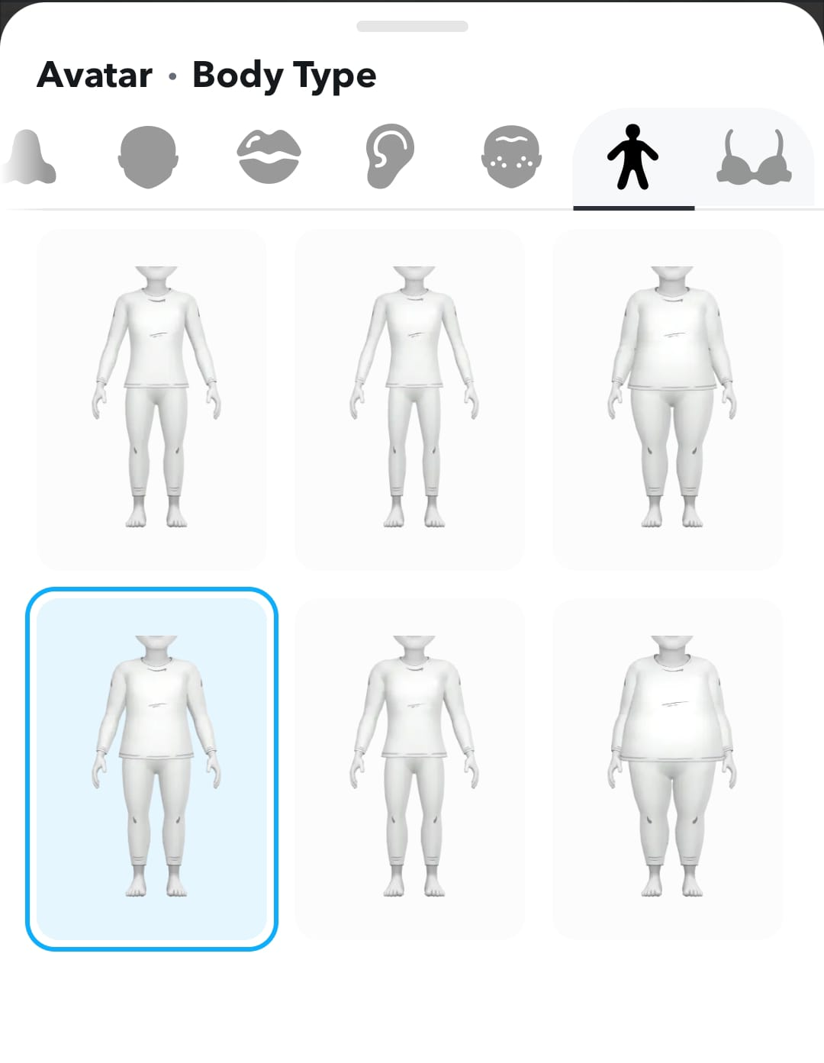
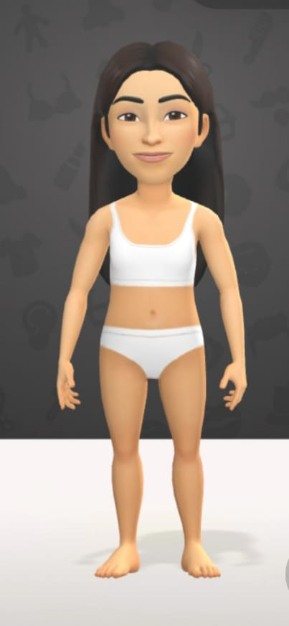
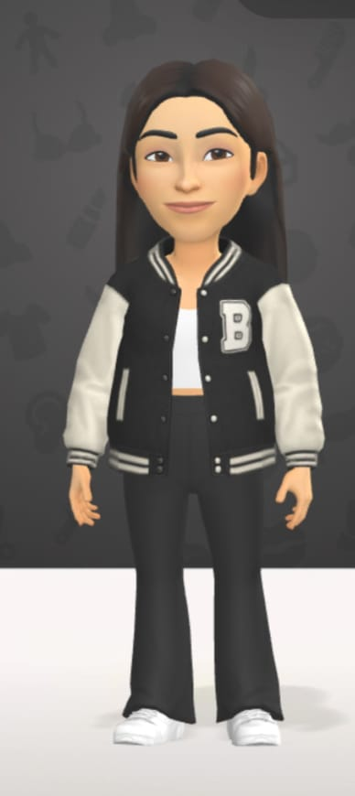
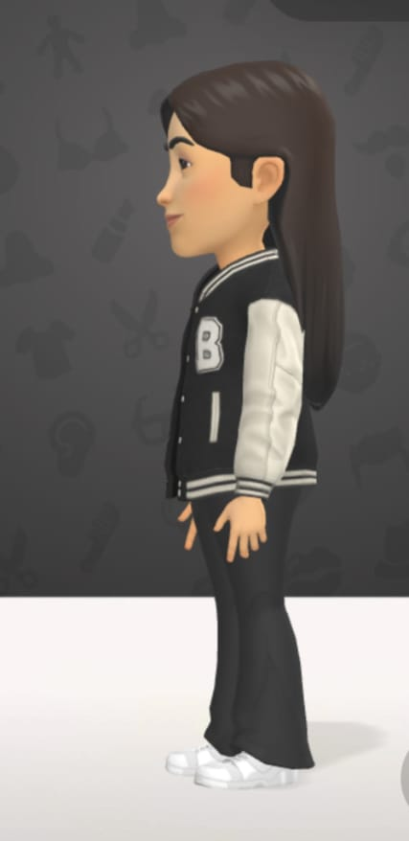
Tech stack used
Virtual Try-On with User-Alike Dummies:, : React, Three.js, HTML, CSS3, Node.js, Python with Flask , Blender, Unity3D , OpenCV. TensorFlow, MongoDB, AWS, RESTful APIs, OAuth or JWT, Docker
Dummy Styling Battles: HTML , CSS, JavaScript, React.js, Three.js, WebSocket, Node.js, Python with Flask, Socket.io, Blender,Unity3D,WebGL,MOngoDB,AWS,Firebase,RESTful APIs, GraphQL, Google Analytics.
3D Model Rendering: HTML, CSS, Tailwind, Bootstrap, Node.js, Python with flask, MongoDB, OAuth, Socket.io, AWS, PayPal APIs.
Additional Features: RESTful APIS, Firebase, User Authentication
Interactive Social Media like feed: HTML, CSS,
Three.js, React.js, Bootstrap, Node.js, MongoDB,
AWS
Token raising system: HTML, CSS, JavaScript, Node.js
Demo Visualization:

